Slide 1
Kaggle Competition:
Drug Mechanisms of Action (MoA) Prediction
Competition Link -
https://www.kaggle.com/isaienkov/mechanisms-of-action-moa-prediction-eda
By: Sammy Lahrime

Slide 2
Motivation
Drug MOA prediction is an extremely useful tool in Drug research and development.
Specifically, being able to predict Drug MOA based off of available data like Cell-viability and gene expression would be useful in the drug candidate selection process

Slide 3
Background: Biology Terminology
Mechanism of Action - The resulting biochemical reactions of an administered drug by which the drug exerts its effects
Gene Expression - The biological process interpreting genetic information to synthesize an associated genetic product (mostly proteins)
Cell Viability - Measure of cell health after a treatment in terms of a proportion of dead and living cells pre-treatment and post-treatment.

Slide 4
Related Work
Mechanisms of Action (MoA) Prediction EDA -
https://www.kaggle.com/isaienkov/mechanisms-of-action-moa-prediction-eda
Drugs Classification Mechanisms of Action -
https://www.kaggle.com/amiiiney/drugs-classification-mechanisms-of-action
Mechanisms of Action Prediction Starter -
https://www.kaggle.com/robikscube/mechanisms-of-action-moa-prediction-starter

Slide 5
Claim / Target Task
Provided the features of gene expression data and cell viability data, classify the MoA responses of different drug samples, provided that each drug may have multiple classifications
Multi-label classification

Slide 6
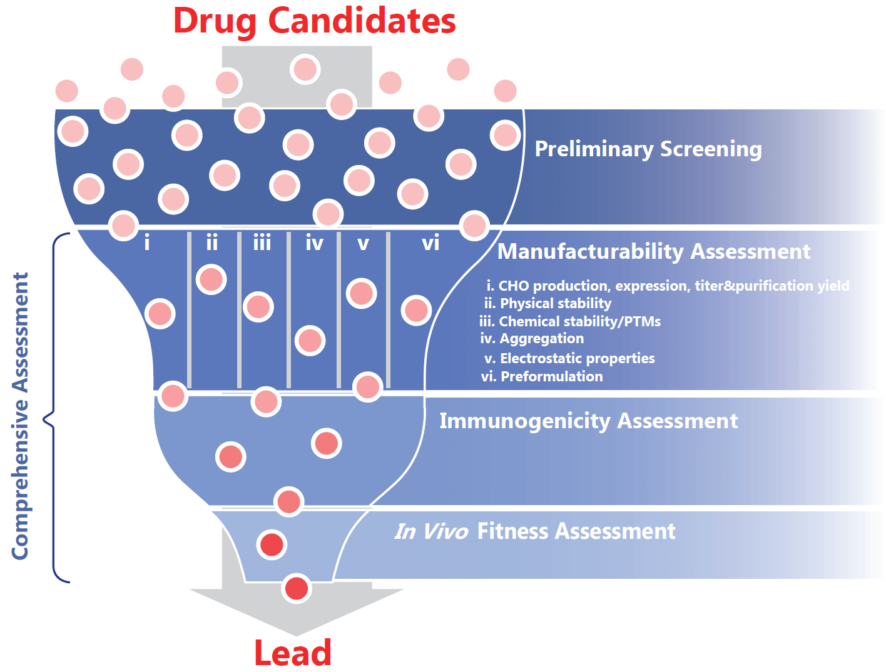
Intuitive Figure 1

Slide 7
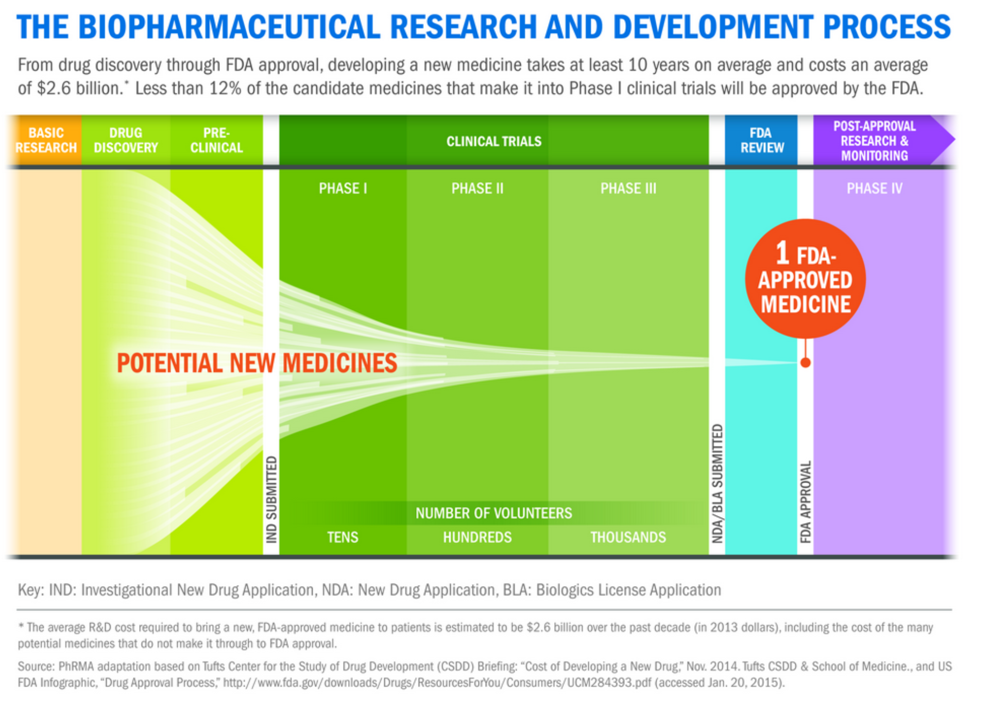
Intuitive Figure 2

Slide 8
Proposed Solution
Preprocess the data (described later)
Train and Tune a Feed Forward Neural Network, experimenting with different optimization techniques

Slide 9
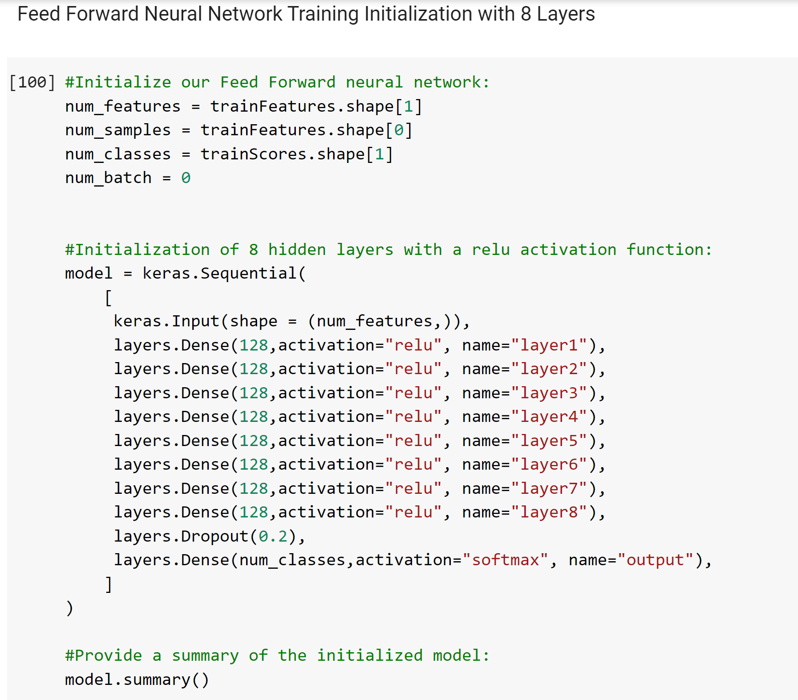
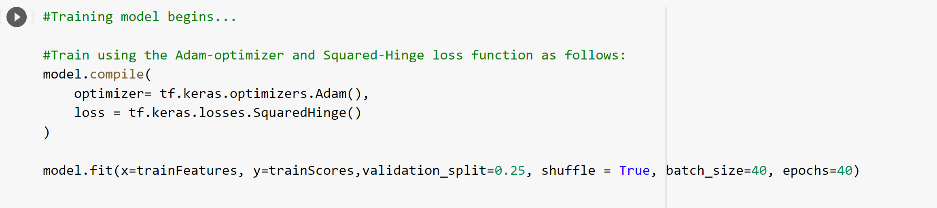
Implementation Part One (Jupiter Demo)

Slide 10
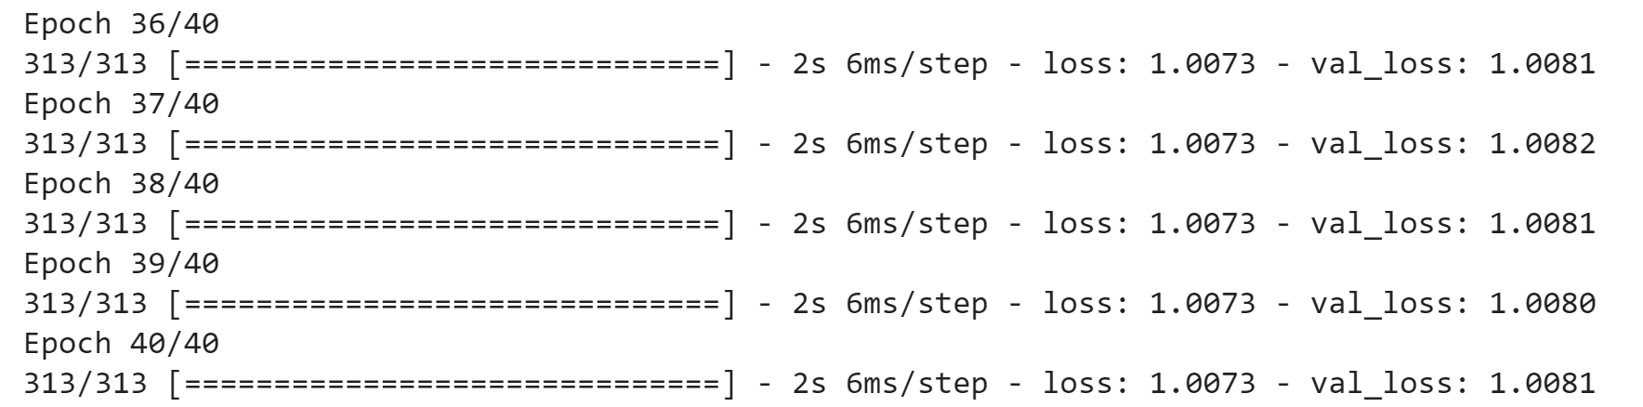
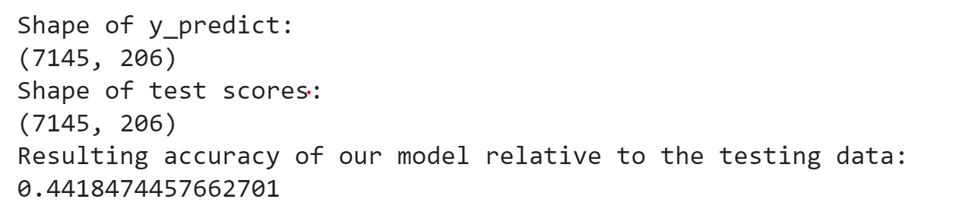
Experimental Results & Analysis

Slide 11
Conclusion and Future Work
There are a lot of optimization techniques that were considered, however they were never fully implemented in this project. They are as follows:
Adam optimizer with weight decay
K-fold-cross validation
Label Smoothing
PCA
Dropout Layers

Slide 12
References
https://www.kaggle.com/simakov/keras-multilabel-neural-network-v1-2
https://www.kaggle.com/riadalmadani/keras-nn-pca-label-smoothing
https://www.kaggle.com/elcaiseri/moa-keras-newbaseline-initializers-featuresengn

